Slide 1
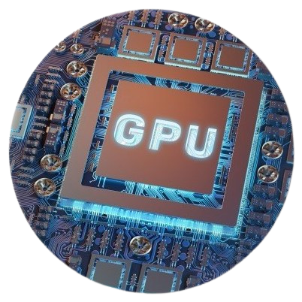
Optimizing Secure Machine Learning with ParSecureML: A GPU-Based Framework
Main project final review
Guide : Dr . K. Rama Krishna (Assistant Professor (Sr.Scale))
Presented by: Batch 20
V. Pavan Kumar (1602-20-737-090)
J. Mahesh Kumar (1602-20-737-080)

Slide 2
PROBLEM STATEMENT
The main issue faced in data computation is the performance degradation caused by security-preserving technologies in two-party computation for machine learning tasks. We aim to overcome this performance degradation by leveraging GPU acceleration to enhance the efficiency of secure machine learning frameworks. The key challenge is to reduce the computational and communication overhead introduced by security measures while maintaining data privacy and confidentiality in a parallel and efficient manner on GPUs.

Slide 3
ABSTRACT
ParSecureML introduces innovative solutions to tackle complex computation patterns, frequent data transmission between CPU and GPU, and intricate inter-node data dependencies.
This project focuses on evaluating the performance of different modules or algorithms by measuring and comparing the time taken to execute specific tasks. The time module in Python will be utilized to accurately measure the execution time of the tasks performed by the different modules or algorithms under consideration.
The framework achieves an impressive average speedup of 33.8x compared to existing solutions, demonstrating its effectiveness in optimizing the efficiency of secure machine learning processes.

Slide 4
Our work
We decreased the complexity of the previous working model.
We created whole project with Python while previous paper has worked with C++ ,make files and shell.
Our project is user friendly and easy to understand.

Slide 5
Literature Survey
S.NO | Title | Authors | Contents
1 | An Efficient Parallel Secure Machine Learning Framework on GPUs | Feng Zhang, Zheng Chen, Chenyang Zhang, Amelie Chi Zhou, Jidong Zhai, Xiaoyong Du | A GPU-based framework that significantly improves the performance of secure machine learning algorithms based on two-party computation by addressing challenges through innovative solutions, achieving an average speedup of 33.8x compared to existing frameworks, and enabling inference with an average speedup of 31.7x.
2 | G-TADOC: Enabling Efficient GPU-Based Text Analytics without Decompression | Feng Zhang, Zaifeng Pan, Yanliang Zhou, Jidong Zhai, Xipeng Shen, O. Mutlu, Xiaoyong Du | G-TADOC is the first GPU-accelerated framework for Text Analytics Directly on Compression (TADOC), overcoming challenges of dependencies, thread synchronization, and sequence preservation. With innovative strategies for workload scheduling, memory management, and sequence support, G-TADOC achieves a remarkable 31.1x speedup compared to existing TADOC solutions, demonstrating the efficiency of GPU-based text analytics on compressed data.

Slide 6
Requirements
Software Requirement
Hardware Requirements
Python 3 compiler platform: Google Colab
pyCUDA
ThreadPoolExecutor
Numba
GPU for parallel computations
CPU for data handling
Servers for distributed environments
RAM :4GB
ROM : 32GB

Slide 7
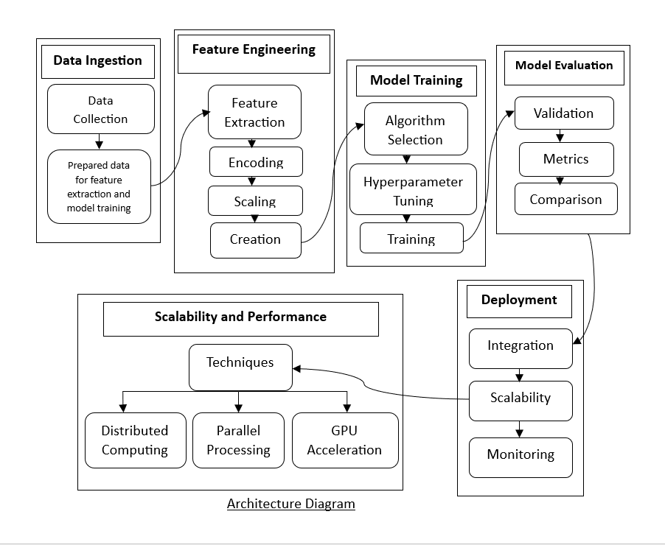
Architecture

Slide 8
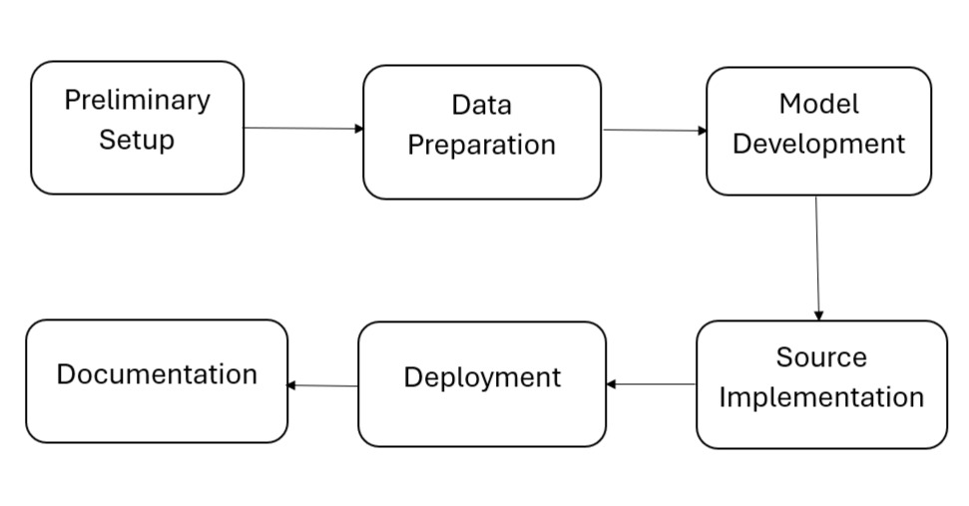
Workflow of ParSecureML framework

Slide 9

Data Sets
VGGFace2
MNIST Dataset
NIST Dataset
CIFAR-10 Dataset
Synthetic Dataset

Slide 10
Framework
ParSecureML is the first parallel secure machine learning framework designed specifically for GPUs, aiming to accelerate secure machine learning tasks while addressing the challenges of computation and communication overhead in a distributed environment.
ParSecureML consists of three major components:
1) Profiling-guided adaptive GPU utilization,
2) Double pipeline execution for overlapping intra-node data transmission and computation, and
3) Compressed transmission for internode communication.

Slide 11
Components of ParSecureML
1. Profiling-Guided Adaptive GPU Utilization
The profiling-guided adaptive GPU utilization technique enables efficient utilization of GPU resources by dynamically allocating computation tasks to the GPU based on profiling information.
2. Double Pipeline Execution for Intra-node CPU-GPU Cooperation
The double pipeline execution for intra-node CPU-GPU cooperation is a critical optimization technique within the ParSecureML framework.
3. Compressed Transmission for Inter-node Communication
The compressed transmission for inter-node communication is a critical optimization technique within the ParSecureML framework.

Slide 12
Modules used for evaluation
Convolutional neural network (CNN or ConvNet)
Linear Regression
Logistic Regression
Support Vector Machine (SVM)
Multilayer Perceptron (MLP)
Recurrent neural network (RNN)

Slide 13
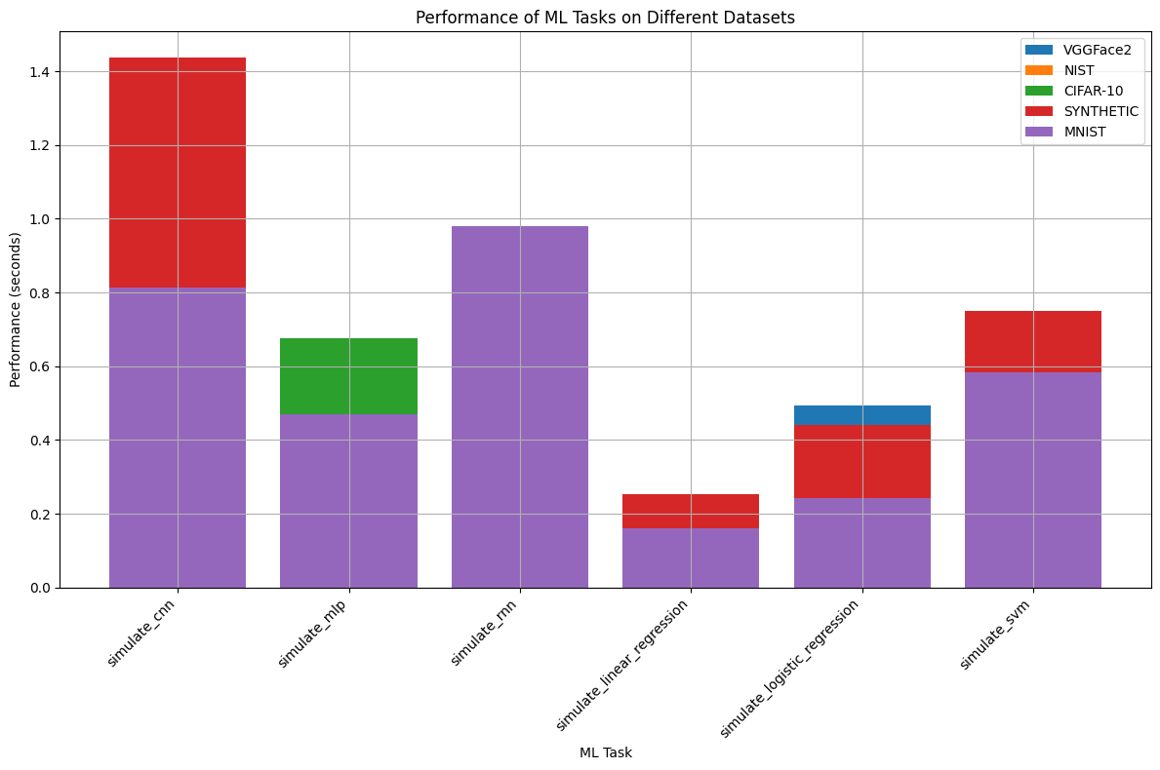
Results and Outputs
Task | Dataset | Performance (seconds)
CNN | VGGFace2 | 1.18
MLP | VGGFace2 | 0.28
RNN | VGGFace2 | 0.41
Linear Regression | VGGFace2 | 0.28
Logistic Regression | VGGFace2 | 0.48
SVM | VGGFace2 | 0.30
CNN | NIST | 1.19
MLP | NIST | 0.61
RNN | NIST | 0.82
Linear Regression | NIST | 0.12
Logistic Regression | NIST | 0.25
SVM | NIST | 0.53
CNN | CIFAR-10 | 1.39
MLP | CIFAR-10 | 0.41
RNN | CIFAR-10 | 0.88
Linear Regression | CIFAR-10 | 0.16
Logistic Regression | CIFAR-10 | 0.41
SVM | CIFAR-10 | 0.67
CNN | SYNTHETIC | 1.40
MLP | SYNTHETIC | 0.21
RNN | SYNTHETIC | 0.55
Linear Regression | SYNTHETIC | 0.21
Logistic Regression | SYNTHETIC | 0.55
SVM | SYNTHETIC | 0.74
CNN | MNIST | 0.76
MLP | MNIST | 0.28
RNN | MNIST | 0.72
Linear Regression | MNIST | 0.28
Logistic Regression | MNIST | 0.46
SVM | MNIST | 0.45

Slide 14
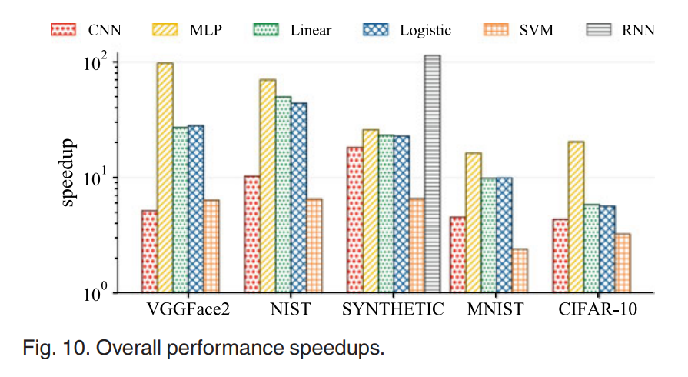
Outputs of previous model and changes
Decreasing Complexity
Increasing Performance
User Friendly

Slide 15
Future scope
Project includes potential advancements in scalability, security enhancements, integration with advanced technologies, real-world applications, optimization strategies, and community engagement. By exploring these avenues, the project aims to enhance performance, security, and applicability in diverse scenarios, while also fostering collaboration and innovation within the secure machine learning community.

Slide 16
Referrences
Z. Chen et al., “ParSecureML: An efficient parallel secure machine learning framework on GPUs,” in Proc. 49th Int. Conf. Parallel Process., 2020, Art. no. 22.
G. A. Seber and A. J. Lee, Linear Regression Analysis, Hoboken, NJ, USA, vol. 936, 2012. D. G. Kleinbaum et al., Logistic Regression. Berlin, Germany: Springer, 2002
F. V. Massoli et al., “Improving multi-scale face recognition using VGGFace2,” in Proc. Int. Conf. Image Anal. Process., 2019

Slide 17

Thank you!

